Slide 1
Core Azure solutions
Theory In Practice

Slide 2
Agenda
Who do you think you are?
Overview
Areas of Focus
Migration Strategy
Administration
Automation
Delivery

Slide 3

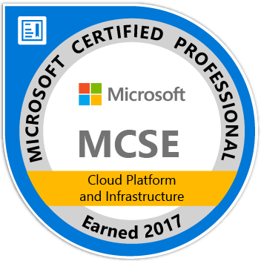
Who I am, What I do, etc.
Josh Garverick
Associate Director, DevOps @ Liazon (sub. Willis Towers Watson)
Buffalo, NY
Twitter: @jgarverick
Blog: https://joshgarverick.blogspot.com
Podcasts: Radio TFS (Sometimes)

Slide 4
Overview
Geared toward technologists considering cloud migration
Platform / Enterprise Perspective
One way to do things (not THE way to do things)
Cloud-First DevOps Lifecycle

Slide 5
What are Core Azure Solutions?
Common scenarios found in real-world datacenters and with real-world applications
Infrastructure Provisioning, Deployment and Usage
Monitoring and Alerting Integrations
Leveraging Component Elasticity / Autoscaling
Platform Redundancy (Disaster Recovery and Business Continuity)
Application / Feature Delivery

Slide 6
Backstory- Liazon
Coordinator of Private Health Insurance Exchanges
Benefits Election/Administration Platform
Bright Choices (US)
approx. 250,000 users
Peak traffic from October 1 – January 10
Benefits Marketplace (International)
approx. 50,000 users
Peak traffic can vary throughout the year

Slide 7
Backstory- WTW
WTW => Willis Towers Watson (!(What the what))
Insurance Brokerage, Risk Management, Financial Management
42000-ish Employees worldwide
Forging a New Strategic direction
Microsoft first, cloud first
Microsoft Core technologies and solutions preferred
Build components, applications, platforms with the cloud in mind
Move select platforms as initial wave of cloud migrations

Slide 8
Migration Strategy
Requirements, Constraints, Risks

Slide 9
Pick a Beanstalk
Greenfield
New Architecture
Same or Modified codebase
Best candidate for “Cloud First” design
Brownfield
Lift and Shift (Usually IaaS)
Hybrid
Often seen as “Less Risky” for existing platforms
Notes:
Greenfield projects are obviously much easier to deal with than brownfield projects.
Lift and shift is usually seen as the easiest path forward since it tends to fall into a pure IaaS scenario. The intent is to lower the barrier of entry to the cloud.
The Azure Migration utility (currently in private preview) helps larger companies using VMWare-run virtualization stacks to move to Azure using a suite of pre-built tools.

Slide 10
The Devil You Likely Know
Infrastructure
Physical (Servers, Blades, Switches, Routers)
Virtual (VMs, Networks)
Security/Compliance
Functional requirements
Application
Composition
Performance
-Abilities (Reliability, Maintainability, Portability, Scalability)
Deployment
Notes:
There are certain requirements you should already know about prior to attempting any migration, whether it’s on-prem to on-prem or on-prem to cloud.
The “-abilities” are also commonly referred to as non-functional requirements.

Slide 11
The Devil You May not Know
Service Level Agreements
Iaas, PaaS Components
SLA given to customers
Component Specs
Security Certifications
HIPAA, HITECH (Healthcare)
PCI DSS 3.0 (Finance)
EU General Data Protection Regulations (GDPR)
Networking
ExpressRoute
VPN
Public Internet
Network Security Groups
Virtual appliances
Notes:
Disclaimer: I am not a security expert. Please consult your resident security expert.

Slide 12
Case Study: Nuts and Bolts
InfoSec and Compliance
HIPAA
PCI DSS 3.0
GDPR / Privacy Shield / Other
disaster recovery scenarios
RTO is 48 hours
RPO is ASAP (Realistically within 20 minutes or less)
ExpressRoute – Theory Vs. Practice
One Egress Per region + MPLS From all Datacenters = bad time
Selective hybrid workloads
Notes:
From an InfoSec perspective, here’s what we are required to support.
Current DR only accounts for a complete redeployment of infrastructure and code to a new datacenter. Given the RTO, this should be attainable through the use of templated environments.

Slide 13
Administration
Managing Up, Down and Sideways

Slide 14
Administrative Concerns
Cost
Documentation
Resiliency
Business Continuity
Disaster Recovery
Security and Authorization
Governance
Compliance

Slide 15
Cost Control
Billing Portal (Enterprise)
Billing blade (Subscription)
Cloudyn (Reporting)
Email Billing Details
Azure Power Cycle Management
Auto Shutoff (All VMs)
Auto Turn On (DevTest Labs)
Azure Automation Runbooks + Tagging
Resource Group Power On/Off with VSTS

Slide 16
Documentation
Baseline/Target/Transition Architectures
Functional / Non-Functional Requirements
Technical Documentation
Azure DocKit (https://www.azuredockit.com)
Diagrams Azure Infrastructure
Documents components used
Includes usage and billing details if you have access to that
Can capture differentials in storage accounts

Slide 17
Redundant Redundancy
Azure Backup and Site Recovery
Great for VM backup and restore using storage account
no managed disk support (Yet)
Storage Accounts
Local, Geo and Zone Redundancy (Storage Accounts)
Azure File Sync
Storsimple
Azure availability zones (Preview)
Notes:
Site Recovery and Backup services will back up your VMs and make them available in a secondary datacenter, in case the unthinkable happens. This only supports traditional storage account based VHDs and not managed disks.
Storage accounts come with several redundancy options.
Azure availability zones (in preview) will give secondary hot-swap locations to provide best-in-class uptime SLAs (99.99%).

Slide 18
OMG with the TLAs
Microsoft Operations management Suite (OMS)
Azure Security Center
Azure active directory
AD Domain Services (DS)
AD Sync
AD Federation Services (FS)
AAD Business to Consumer (B2C)
FFS U GOIS
Notes:
Operations management suite covers the monitoring of platform performance, health, security, patching, and vulnerability.
Security Center gives you insights into best practices, threat detection, etc.
Holy shit with these Active Directory acronyms.
Domain Services is a flattened out directory of users, objects and networks typically used for single-tenant authN / authZ
Federation Services is a full-bodied pour of Active Directory, with multiple domains, OU structures; allows for Windows AD authN / authZ via claims-based credentials (SSO)
B2B allows a business who’s doing business with another business to integrate that business into its AD tenant for access to securable resources (API consumption for example)
B2C allows a business who’s doing business with lots of businesses and customers to integrate those businesses and customers into its tenant for faster authN.

Slide 19
Case Study: Administrative Zen
Operations Management Suite
Azure Security Center
Managed Backups (via managed disk usage)
Notes:
Kick out the jams, motherfucker

Slide 20
Automation
Remove Human Interaction Wherever Possible

Slide 21
Script First, Ask Questions Later
Automation R&R
Repeatable
Reliable
Azure automation
Configuration Management
Infrastructure as Code
Configuration as code

Slide 22
Azure Automation
Define Runbooks for common tasks
Schedule jobs to run said runbooks
Pull server for Powershell DSC
Credentials and Certificates
Supports Azure and On-Prem Servers
Oh, and some New Stuff
Update management
Inventory
Change tracking

Slide 23
Configuration Management
Infrastructure as Code
Azure Resource Manager (ARM)
Azure Building Blocks
Chef
Puppet
Ansible
Terraform

Slide 24
Configuration Management
Configuration as code
PowerShell DSC
Chef
Puppet
Ansible

Slide 25
Case Study: Automate Your Life
Automate provisioning and setup
Powershell
DSC
Ansible (linux only)
Azure Resource Manager templates

Slide 26
Delivery
Cloud-First DevOps Lifecycle

Slide 27
Cloud Fist, er, First
Compute Resources: Pets vs. Cattle
Always require a herd
Prepare for Stampedes
Failure Driven Development
Write it like you expect others to break it
Test it like you plan to break it
Ship it into fault-tolerant waters
Curate the Culture

Slide 28
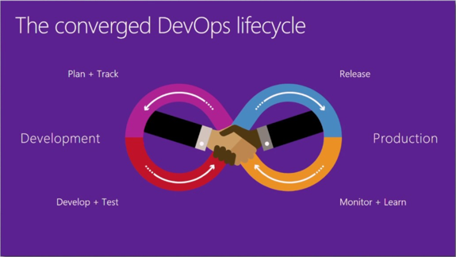
The lazy (crazy?) Eight Feedback Loop
Plan and Track
Develop and Test
Release
Monitor and Learn

Slide 29
Developer Experience
Remove Friction and Roadblocks
Empower teams to own CI/CD Definitions
Empower everyone to communicate changes
Provide repeatable building blocks to promote consistency
Create a space to safely fail
Sandbox Resource Groups
DevTest Labs
Incorporate static analysis tools
SonarQube – your code
Whitesource – everyone else’s code

Slide 30
Operations Experience
Monitor all the things
Component performance / uptime
Runtime exceptions
Threat Detection
Alert A few of the things
Reduce noise in alert aggregation
Clearly define escalation policies
Clearly Define decision trees

Slide 31
Case Study: VSTS and Friends
Work Item Tracking
Test Case Management
Build Management
CI builds per mainline (master, Develop, Release)
Whitesource integration during CI
Scheduled SonarQube analysis builds
Release Management
Separate release definitions for code, Infrastructure
Role Based Access Control to delegate between definitions
Monitoring and Alerting (The Friends part)
New Relic
OMS
Pagerduty

Slide 32
If you take nothing else away…
Be Real with yourselves
Define realistic migration timelines
Engage with corporate resources as early as possible
Changing culture is hard
Don’t Cut Corners
The day to day will get In your way – plan for it
Beware of “Agile Speed Demons”
Script first, ask questions later
Embrace failure driven development

Slide 33
Q&A
Bueller? Bueller?

Slide 34

Thank you!

